Slide 1
An Investigation into Imposter Syndrome
Najia Pan, Neftali Lemus, Orion Shi, Sebastian Rivera-Chepetla, Yao Zhang, and Yilin Xu
Notes:
Good afternoon everyone, we are Group 3 Section A and we are presenting our final project on imposter syndrome.

Slide 2
Definitions of Imposter Syndrome
From Literature
Experience no internal sense of success while being objectively high-achieving (Clance and Imes, 1978).
A set of self-referential ideas centered around perceived fraudulence (Kolligian and Sternberg, 1991).
Feelings of inauthenticity is the singular driving force behind imposter syndrome (Leary et al., 2000).
Our Definition
Imposter syndrome is a phenomenon that a person believes they are not as successful as others think they are and feels they do not deserve the position or role they currently have.
Notes:
Hearing the topic of our project, some of you might be confused about what imposter syndrome is. In order to formulate our own definition, we referred to definitions given by researchers in past literatures as you can see on the left. From those definitions, we generated our own on the right hand side of the screen. (READ THE DEFINITION QUICK)

Slide 3
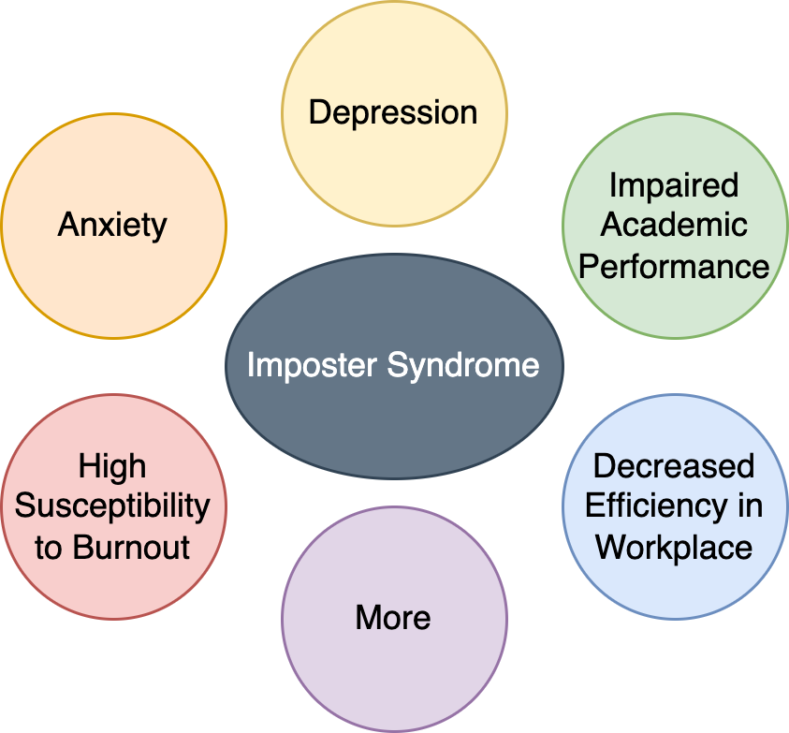
Why Should We Care?
(Bravata et al., 2020; Weir, 2013)
Notes:
So, given the definition of imposter syndrome, why should we care about it? According to past researches, imposter syndromes are accompanied with anxiety, depression, impaired academic performance, high susceptibility to burnout, decreased efficiency in workplace and more.

Slide 4
Research Questions
Can we predict a person’s imposter syndrome score from existing scales using a newly developed scale that contains statements pertaining specifically to their experiences at UCLA?
Notes:
With these knowledge in mind, we asked our research questions.
(READ THE QUESTION QUICK)

Slide 5
Research Questions
Can we predict the odds of a person being impacted by imposter syndrome using statements from the newly developed scale that contains statements pertaining specifically to their experiences at UCLA?
Notes:
(READ THE QUESTION QUICK)

Slide 6
Research Questions
Does the design of our project have high ecological validity? More specifically, do the results from our study match with what people think of imposter syndrome in reality?
Notes:
(READ THE QUESTION QUICK)

Slide 7
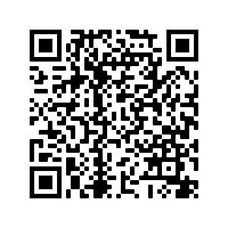
Survey Distribution
The survey was distributed to students enrolled in STATS 140XP, PSYCH 124C, and SOC 101.
We collected 89 complete responses.
Participation was voluntary, and participants was able to leave some questions blank if they didn’t wish to answer.
Notes:
One thing essential to our project is that we collected our own dataset since there is no preexisting ones we can use. Scan the QR code on the left, you can see our survey in viewer’s mode. This survey is distributed to UCLA students enrolled in the following class shown on the right hand side which includes both STEM and non-STEM courses. In total, we collected 89 responses.

Slide 8
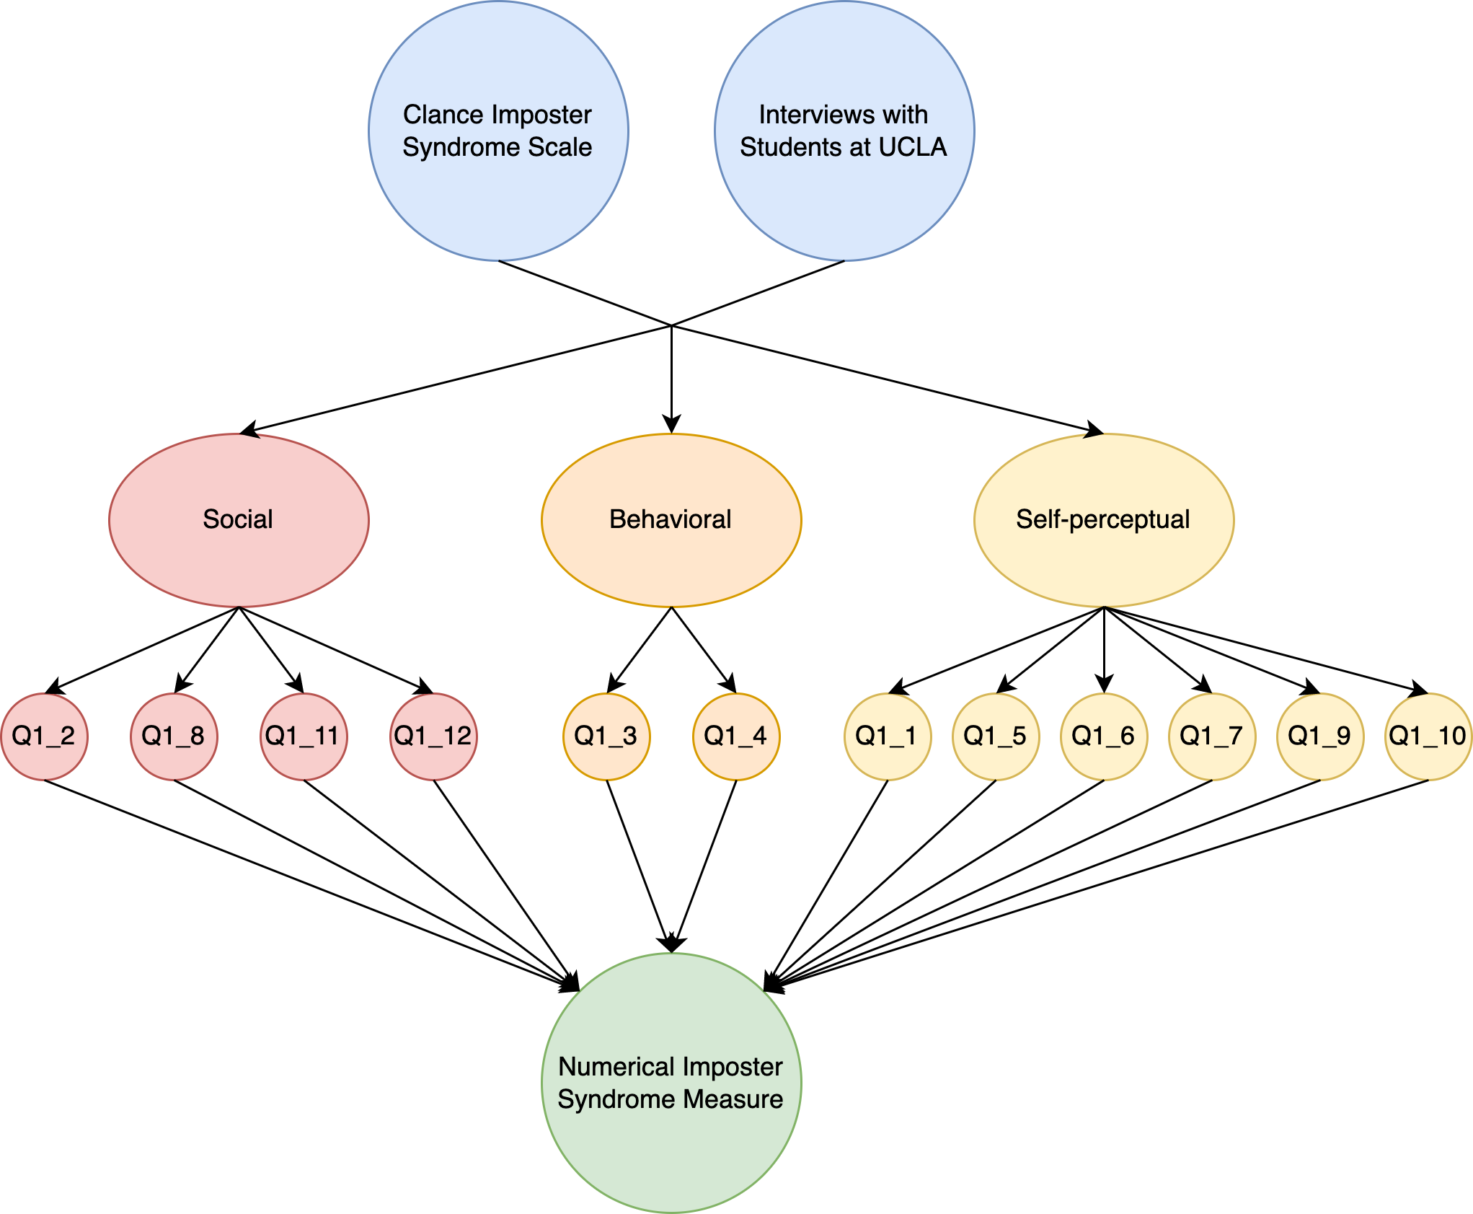
Numerical Imposter Syndrome Measure
12 statements were included for calculating a numerical measure of imposter syndrome.
Consists of statements paraphrased from the Clance Imposter Phenomenon Scale (CIPS; Clance, 1985) and those summarized from interviews with students at UCLA.
Contains statements from three dimensions: social, behavioral, and self-perceptual.
Each statement is rated from 1 to 7, where 1 indicates strongly disagree and 7 indicates strongly agree.
Final score is calculated by summing scores on all 12 questions
Final score ranges from 7 to 84. A higher score means a person is more severely affected by imposter syndrome.
Notes:
For the design of our survey, we included 12 statements for calculating a numerical measure of imposter syndrome. These statements were selected either from the Clance Imposter Phenomenon Scale from prior research, or summarized from interviews with students at UCLA. The statements can be grouped into three cohorts: social, behavioral, and self-perceptual. Each statement is rated on a scale from 1 to 7, where 1 and 7 mean strongly disagree and agree, respectively. All scores are added up to form a final score. And a higher score means a higher imposter syndrome severity.

Slide 9
Example Statements from the Survey
“I feel anxious about being judged by others.”
Example from the social cohort.
“I tend to avoid challenging tasks.”
Example from the behavioral cohort.
“I have high expectations of myself.”
Example from the self-perceptual cohort.
Notes:
These are some of the example statements for calculating imposter syndrome scores.

Slide 10
Scoring Scale from the Survey
Strongly disagree | Disagree | Somewhat disagree | Neither agree or disagree | Somewhat agree | Agree | Strongly agree
1 | 2 | 3 | 4 | 5 | 6 | 7
Notes:
And here’s the scale for rating each statement.

Slide 11
Categorical Imposter Syndrome Measure
“Do you think you are impacted by imposter syndrome?”
A self-reported variable with three levels: yes, no, and maybe.
More on how we used the responses from this questions later.
Notes:
The categorical measure of imposter syndrome comes from a self-reported answer to question 3, which is “do you think you are impacted by imposter syndrome?”. Possible responses include yes, no, and maybe. We will come back to this measure later in the presentation.

Slide 12
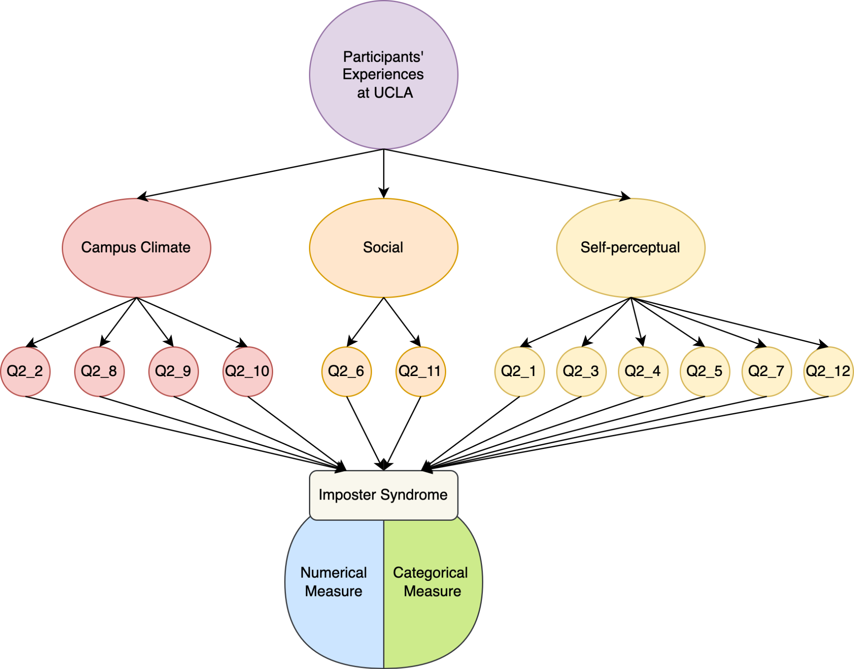
Predictor Statements
12 statements were included to serve as predictors.
Designed specifically to capture elements of a person’s experiences at UCLA.
Contains statements from three dimensions: campus climate, social, and self-perceptual
Each statement is rated from 1 to 7, where 1 indicates strongly disagree and 7 indicates strongly agree.
Statements were selected to avoid direct overlap with statements from the existing scales.
If an element is too important to be removed because of overlap, it is either modified to be an extension or a more specific version of the previous statement.
Notes:
The predictors of our study include 12 statements pertaining specifically to people’s experiences at UCLA. The statements are grouped into three categories: campus climate, social, and self-perceptual. All statements are rating on the same scale as before. One thing to note is that, all statements were selected to avoid direct overlap with statements we used to calculate imposter syndrome scores. We’ll show you an example shortly. We will use these statements to predict both the numerical and the categorical measure of imposter syndrome later in the study.

Slide 13
Example Statements from the Survey
“I feel people like myself are underrepresented at UCLA.”
Example from the campus climate cohort.
“I think the appraisals I get from others are insincere.”
Example from the social cohort.
“I think I am not academically competent.”
Example from the self-perceptual cohort.
Notes:
Here are some example statements that serve as our predictors.

Slide 14
Example Statement Modification
“I attribute my success to luck rather than hard work.”
Luck, or locus of control, is the element of imposter syndrome captured here.
“I doubt if I can repeat my academic successes.”
Notes:
Here’s an example of how we modify the statements. The first statement is used for calculating a imposter syndrome score, and it captures locus of control as the key element. We translated “locus of control’ into ”repeating successes“ to extend the statement. We also gave it a more specific context by putting it into a academic setting.

Slide 15
Scoring Scale from the Survey
Strongly disagree | Disagree | Somewhat disagree | Neither agree or disagree | Somewhat agree | Agree | Strongly agree
1 | 2 | 3 | 4 | 5 | 6 | 7
Notes:
Here’s the scoring scale for our predictors, which is identical to the one we used for calculating imposter syndrome scores.

Slide 16
Exploratory Data Analysis

Slide 17
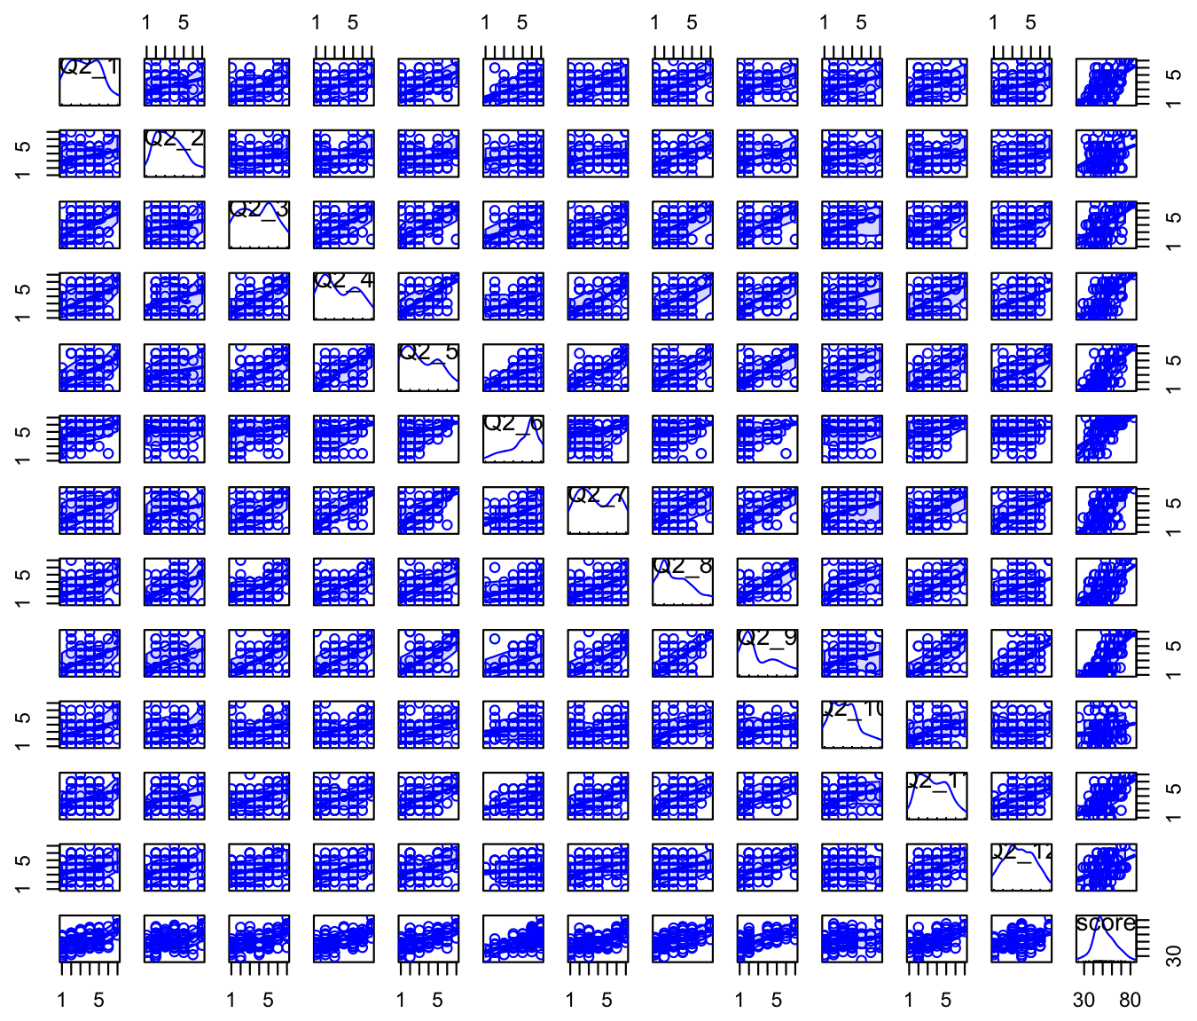
Scatterplot Matrix
Given that our sample size is relatively small, we expected most numerical predictors to not be perfectly normally distributed.
Most predictors appear not to deviate too much from normal distribution.
All predictors seem to be linearly correlated with the numerical outcome variable, indicating that a linear model might fit the data well.

Slide 18
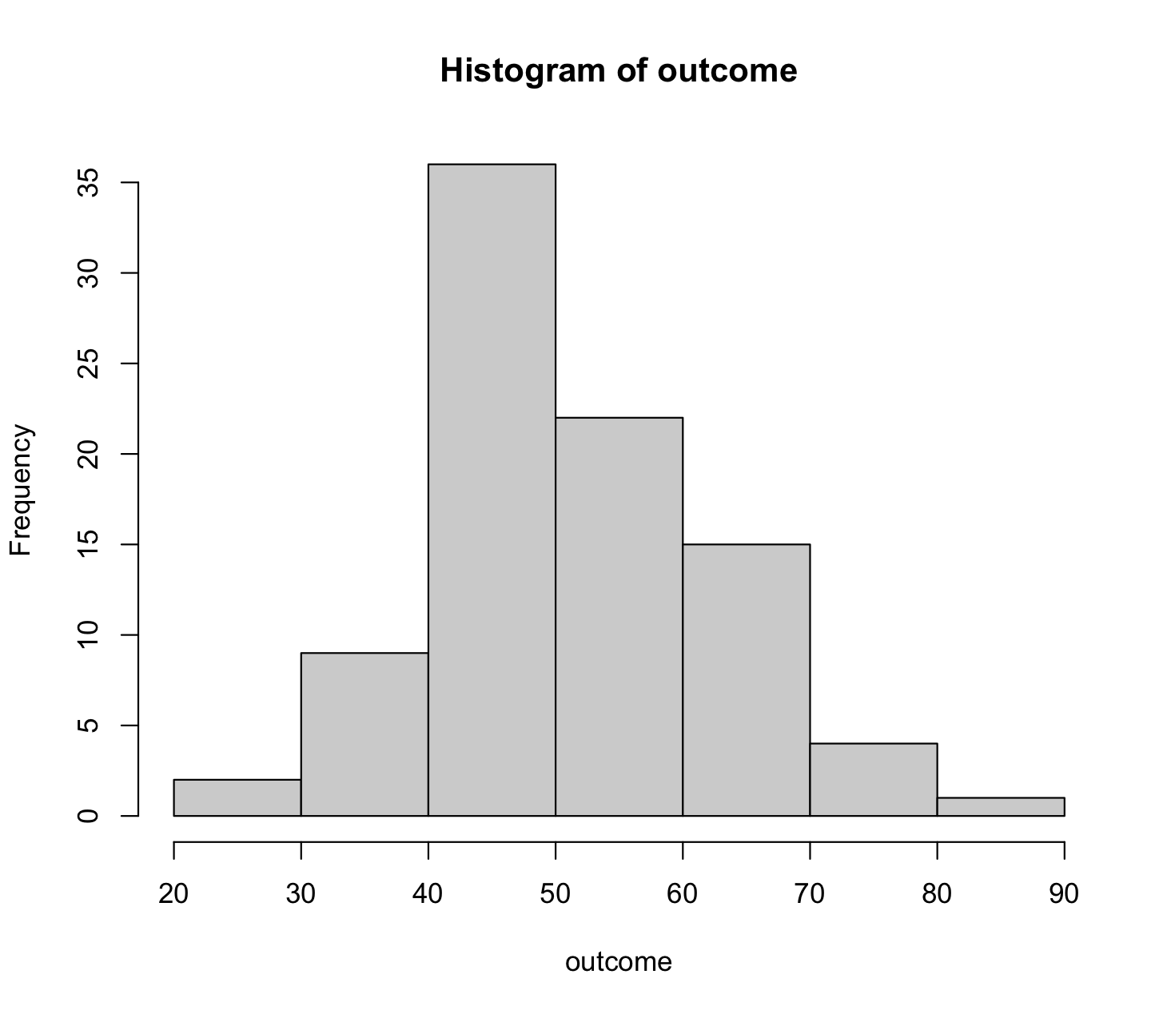
Numerical Imposter Syndrome Score (Outcome)
The outcome variable looks normally distributed. The conclusion is also support by the Shapiro-Wilk test for normality (p-value = 0.4021).

Slide 19
Grouping Variables: Gender
Frequency table of gender
 | male | female
count | 49 | 40
Balanced
Notes:
The distribution of gender was overall pretty balanced.

Slide 20
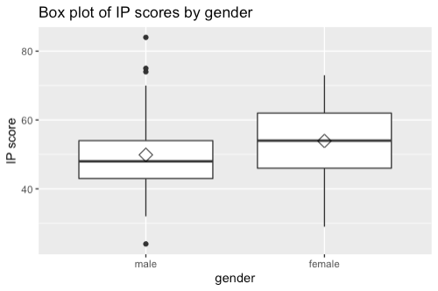
Box plot with Group Mean
Females seem to have higher imposter syndrome scores than males, but the difference is not statistically significant (p-value = 0.0991; SLR).
Notes:
By looking at the following plot we can see the distribution among gender vs Imposter syndrome Scores (or IP) that ranges from 7 to 84, accounting for the severity of this condition. We can see that on average females seem to have higher scores but their difference was found not to be statistically significant.

Slide 21
Grouping Variables: Sexual Orientation
Frequency table of sexual orientation
 | heterosexual | homosexual | bisexual | self-describe
count | 71 | 6 | 8 | 4
 | non-LGBT | LGBT
count | 18 | 71
Imbalanced
Notes:
Regarding sexual orientation we found a pretty unbalanced data set and decided to merge categories to reduce bias.

Slide 22
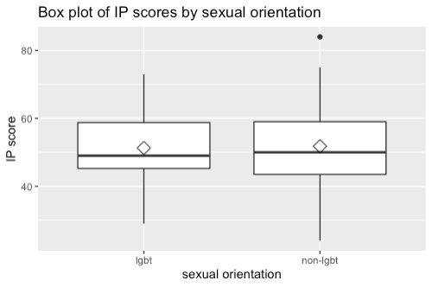
Box plot with Group Mean
Imposter syndrome score does not differ by sexual orientation (p-value = 0.867; SLR).
Notes:
However this measure had one of the highest P values in the data, meaning that it had little to no effect in the relationship that we are trying explain.

Slide 23
Grouping Variables: Ethnicity
Frequency table of ethnicity
 | White | Black | American Indian or Alaska Native | Asian | Native Hawaiian or Pacific Islander | Self- describe
count | 8 | 3 | 2 | 71 | 0 | 5
 | Asian | Others
count | 71 | 18
Imbalanced
Notes:
Likewise, ethnicity demonstrated similar data distributions and non-significant differences among the means.

Slide 24
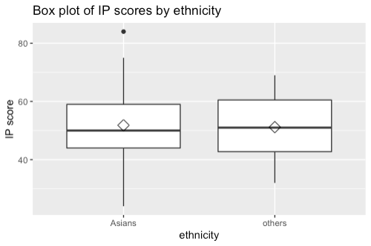
Box plot with Group Mean
Imposter syndrome score does not differ by ethnicity (p-value = 0.831; SLR).

Slide 25
Grouping Variables: Age
Frequency table of age
 | 18 | 19 | 20 | 21 | 22 | 23 | 24 | 25 | 26 | 28 | 29 | 31
count | 3 | 6 | 10 | 36 | 17 | 5 | 4 | 3 | 2 | 1 | 1 | 1
 | 21 | Below 21 | Above 21
count | 34 | 36 | 19
Balanced
Notes:
Age had a wide distribution of values, giving us enough information to merge everything into three different groups, 21, below 21 and above 21.

Slide 26
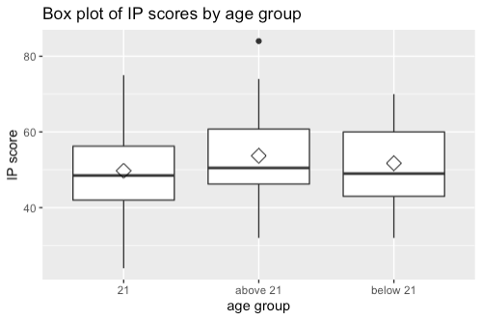
Box plot with Group Mean
Imposter syndrome score seems to be higher for people above 21, but the difference is not statistically significant (p-value = 0.355; one-way ANOVA).
Notes:
People above 21 seem to have higher means but once again, the difference is not significant.

Slide 27
Grouping Variables: Major
Frequency table of major
 | non-STEM | STEM | both
count | 12 | 69 | 10
 | non-STEM | STEM
count | 22 | 67
Somewhat imbalanced
Notes:
For major we had a similar approach, merging data to understand its distribution.

Slide 28
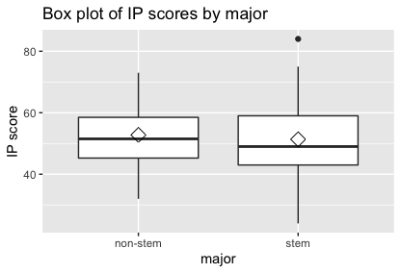
Box plot with Group Mean
Imposter syndrome score does not differ between people majoring in non-STEM and those majoring in STEM (p-value = 0.611; SLR).

Slide 29
Grouping Variables: GPA
Frequency table of GPA
 | Below 2.00 | 2.00 - 2.49 | 2.50 - 2.99 | 3.00 - 3.49 | 3.50 - 3.99 | 4.0
count | 0 | 1 | 3 | 22 | 54 | 9
 | Above 3.5 | Below 3.5
count | 63 | 26
Somewhat Imbalanced/balanced
Notes:
GPA on the other side gave use more consistent results in our general relationship towards IP. We decided to split GPA by below and above 3.5.

Slide 30
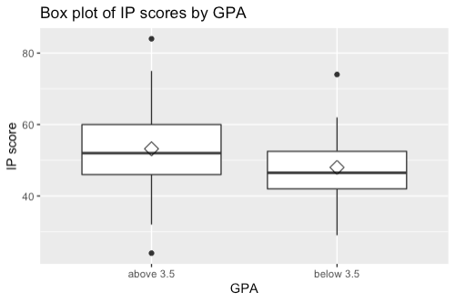
Box plot with Group Mean
Imposter syndrome score seems to be higher for people with GPAs above 3.5, the difference is marginally significant (p-value = 0.0503; SLR).
Notes:
And the plot of the means gave a marginally significant result, showing that as GPA increases, IP scores increase.

Slide 31
Models
Notes:
Up to this point, most of the previous variables turned out to non-significant, this due to the small data set, and it is one of the key limitations to keep in mind through our model.

Slide 32
Part I:
Numerical Outcome

Slide 33
Variable Selection
Methods
Least absolute shrinkage and selection operator (LASSO)
Best subset selection
Forward stepwise selection
Backward stepwise selection
Compare results across different methods and select the recurring important variables.
Start with no interaction effects and add them in after we obtain a simplified linear model.
Notes:
For the numerical part of this project we went with a MLR model and after cleaning the data we used many variable section methods such as LASSO, Regsubsets & and Forward and Backward stepwise functions. Out of all the outputs we chose the most recurring predictors.

Slide 34
Interpretation of LASSO coefficients
Because we relied on LASSO for its feature selection function, we will focus more on the practical rather than the mathematical aspect.
In addition, because our data set is relatively small (N = 89), we used LASSO mainly as a means to understand patterns within the data set instead of using it to construct models for future predictions.
Coefficients are shown in the s1 column of the tables. A general rule of interpreting the coefficients is that, variables with greater absolute coefficients are judged by LASSO to be more important toward making the final prediction.
LASSO shrinks the coefficients of unimportant variables to zero. In the tables shown, zero coefficient appears as a dot.
Q2_4, Q2_5, Q2_6, Q2_9, sexual orientation, ethnicity, age, and GPA are the most important predictors of all.
Sexual orientation and ethnicity are imbalanced categorical variable, therefore we need to interpret this result with caution
We employed three more variable selection methods to validate the result from LASSO.
 | s1
Intercept | 24.093
Q2_1 | 0.650
Q2_2 | 0.453
Q2_3 | .
Q2_4 | 0.728
Q2_5 | 0.821
Q2_6 | 1.501
Q2_7 | 0.488
Q2_8 | .
Q2_9 | 1.404
 | s1
Q2_10 | 0.650
Q2_11 | 0.453
Q2_12 | .
Q5male | .
Q6non-lgbt | 2.348
Q7others | 1.833
Q8above21 | 1.004
Q8below21 | .
Q10stem | 0.237
Q11below | -3.861
Notes:
In brief, Lasso is a type of linear regression that shrinks variables to eliminate multicollinearity, where the dots in the output represent a coefficient of zero.

Slide 35
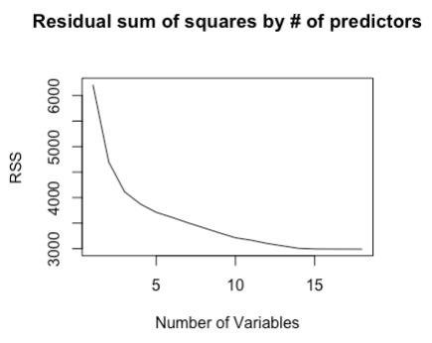
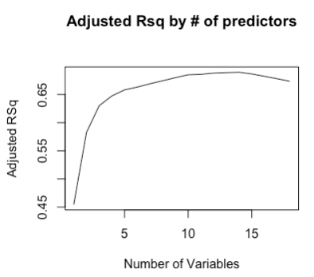
Interpretation of best subset selection
In short, best subset selection fits all possible combination of predictors to select the best performing model
In our case, there would be 2^{p} = 262144 models fitted.
We can see from the plot that as the number of predictors entered in the model increases, residual sum of squares decreases. Also, as the number of predictors increases, adjusted R-squared shows an overall increasing trend as well. However, the increase stops after 14 or more predictors are entered.
For simplicity and interpretability of our model, we conclude that the optimal number of predictors is 4.
This is because after 4 predictors, the decrease in RSS and the increase in adjusted R-squared slow down, indicating that the improvements become more and more trivial after this number.
Notes:
Fits all possible predictor combinations and outputs the best performing subset. The plots shows the relationship between RSS and Adjusted R^2 against the number of predictors, where 4 predictors seem to be optimal as it has a low RSS and a high R^2 Adjusted.

Slide 36
Forward and Backward Stepwise Selection
Forward
 | (Intercept) | Q2_4 | Q2_6 | Q2_9 | Q11
coefficient | 28.977 | 1.641 | 1.192 | 2.684 | -3.945
Backward
 | (Intercept) | Q2_4 | Q2_6 | Q2_9 | Q11
coefficient | 28.977 | 1.641 | 1.192 | 2.684 | -3.945
Q2_4, Q2_6, Q2_9, and Q11 are consistently the most important predictors, therefore they will be entered in our linear regression model.
Notes:
Likewise, these two functions gave us a similar subset and after compiling all the results we concluded that Q2_4, Q2_6, Q2_ 9 and Q_211 are the most significant predictors.

Slide 37
Model Output
 | Estimate | Std. Error | t value | p value | Sig. Level
(Intercept) | 28.9773 | 2.8022 | 10.341 | <2e-16 | ***
Q2_4 | 1.6411 | 0.4567 | 3.593 | 0.000550 | ***
Q2_6 | 1.9156 | 0.5210 | 3.677 | 0.000415 | ***
Q2_9 | 2.6845 | 0.4664 | 5.756 | 1.37e-07 | ***
Q11below 3.5 | -3.9450 | 1.7306 | -2.280 | 0.025166 | *
R-squared = 0.6636; adjusted R-squared = 0.6475

Slide 38
Model Output Interpretation
Intercept: Imposter Syndrome Score
Q2_4: “I doubt if I can repeat my academic successes.”
Feelings of fraudulence.
Q2_6: “I tend to compare myself with others.”
Tendency to compare.
Q2_9: “I do not think I belong at UCLA.”
Feelings of estrangement.
Q11: GPA (baseline = above 3.5)

Slide 39
Multicollinearity
 | VIF
Q2_4 | 1.529214
Q2_6 | 1.357551
Q2_9 | 1.572224
Q11 | 1.185658
There is no issue with multicollinearity. The VIF value associated with each predictor is low, which indicates they are not correlated with one another.
Notes:
There is no issue with multicollinearity, meaning that our predictors are independent of each other.

Slide 40
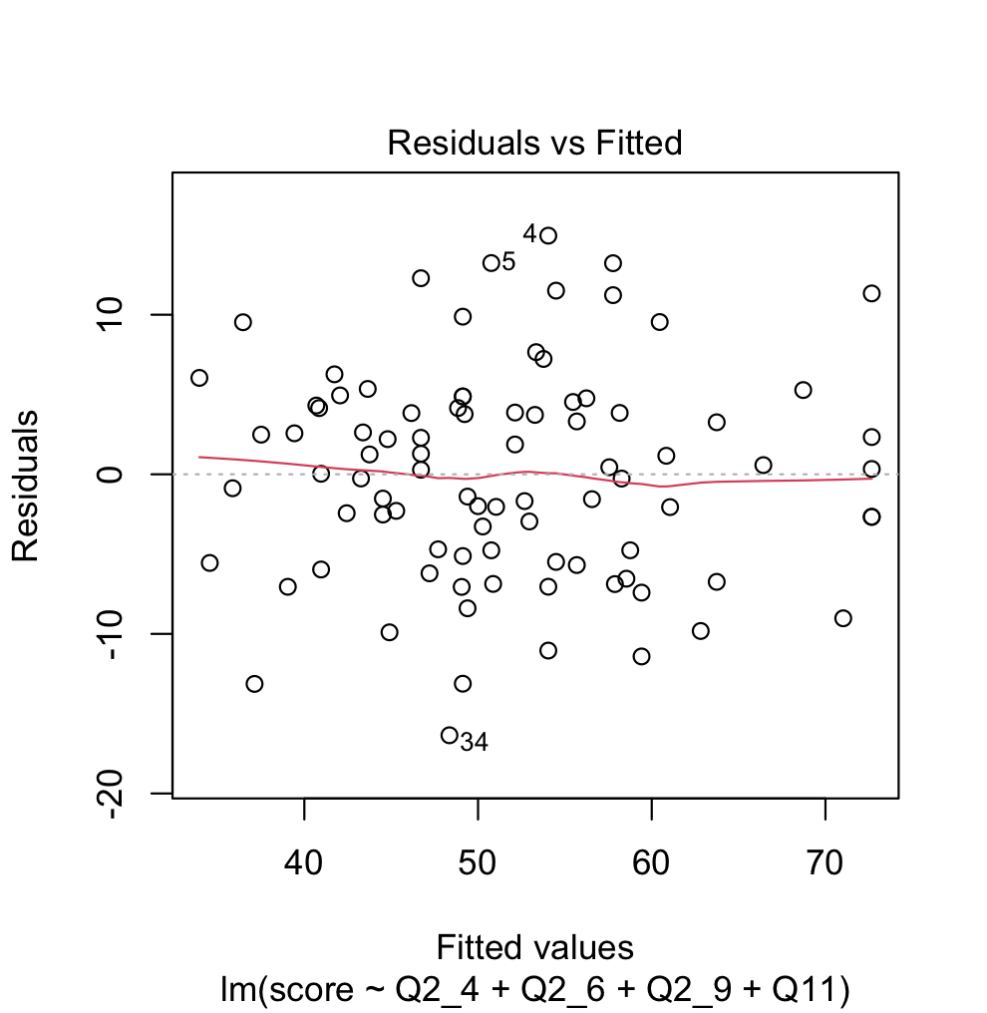
Equality of Error Variance
There is no pattern in the plot, which indicates that there is no correlation between the residuals and the predicted values.

Slide 41
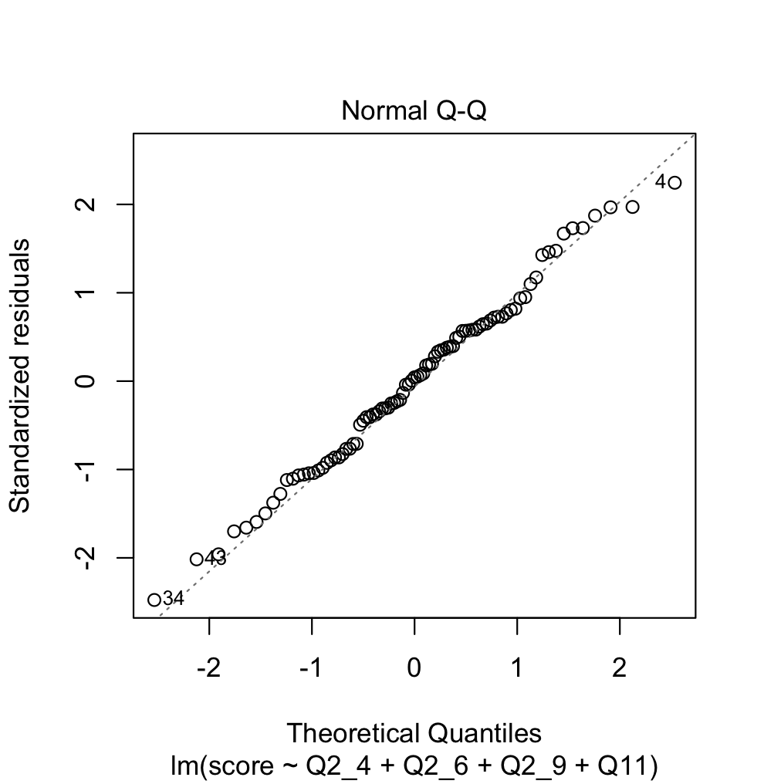
Normality
Most observations fall in the the line, however, there are some misleading observations at the edges.
Notes:
We comply with normality as most points fall in the diagonal line but we have some misleading points that we need to look into.

Slide 42
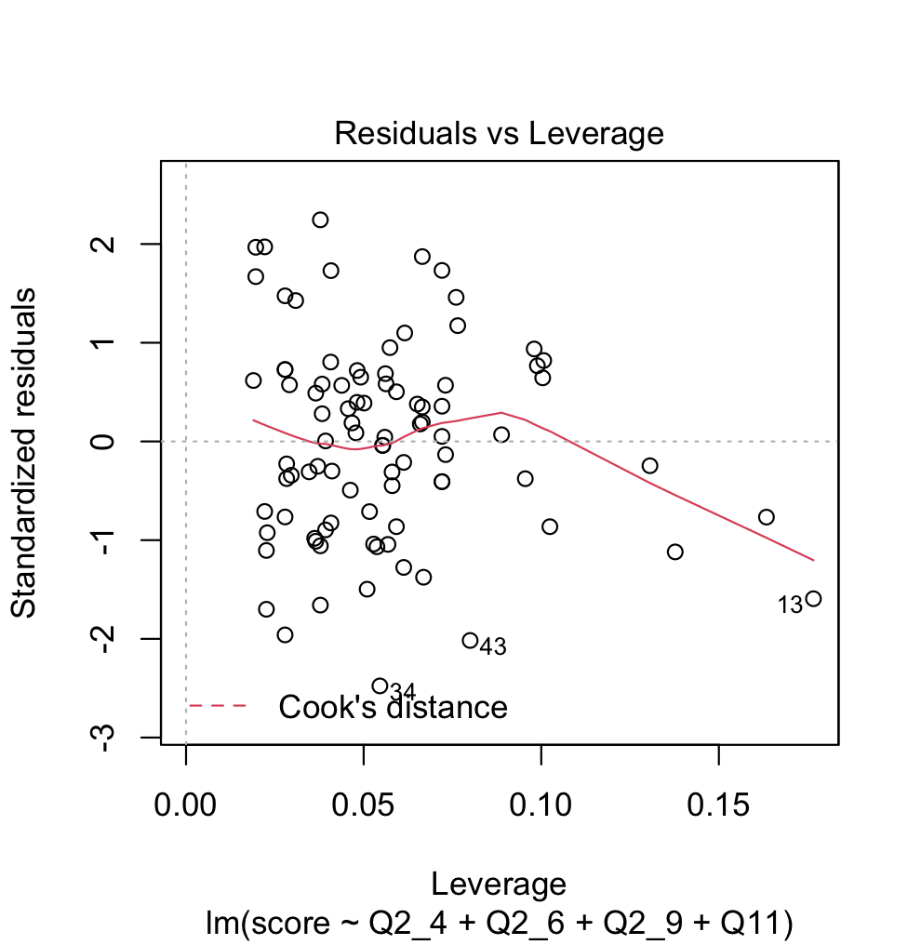
Outliers and Influential Points
All points seem to be within the Cook’s distance.
A small data set has a (-2,2) range for standardized residuals.
There are several outliers in the data.
Notes:
All points seem to be within Cook’s distance but we need to further look into this as some are out of the standardized residuals range of (-2,2).

Slide 43
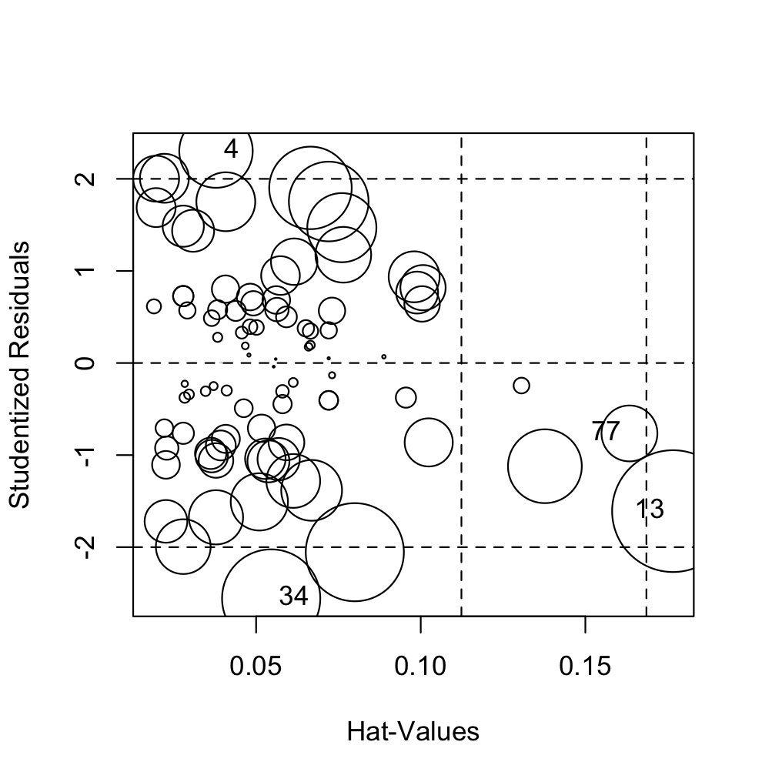
Outliers and Influential Points Continued
 | StudRes | Hat | Type
4 | 2.3018084 | 0.03780997 | No Leverage
13 | -1.6084707 | 0.17662806 | Good leverage
34 | -2.5570384 | 0.5456995 | Bad leverage
77 | -0.767405 | 0.16339302 | Good leverage
Leverage cutoff: 4 / 89 = 0.04494382
We decided to remove observation #34 from the data.
Notes:
We decided to remove points 4 and 34 from the data but the increase in total variance was minimum.

Slide 44
Model with Interaction
Imposter syndrome disproportionately affect high achieving women (Clance & Imes, 1978).
If we use GPA to define achievement, could there be a interaction between gender and GPA?
Notes:
Aside from the linear model we introduced an interaction between GPA and Gender.

Slide 45
Model Output
 | Estimate | Std. Error | t value | p value | Sig. Level
(Intercept) | 28.9191 | 2.8364 | 10.196 | 4.02e-16 | ***
Q2_4 | 1.4127 | 0.4454 | 3.171 | 0.00215 | **
Q2_6 | 2.1539 | 0.4967 | 4.336 | 4.19e-05 | ***
Q2_9 | 2.7455 | 0.4454 | 6.164 | 2.71e-08 | ***
Q11below 3.5 | -7.7027 | 2.7065 | -2.846 | 0.00562 | **
Q5male | -1.3018 | 1.6853 | -0.772 | 0.44212
Q11below 3.5:Q5male | 5.9582 | 3.2754 | 1.819 | 0.07264 | .
R-squared = 0.7011; adjusted R-squared = 0.6787

Slide 46
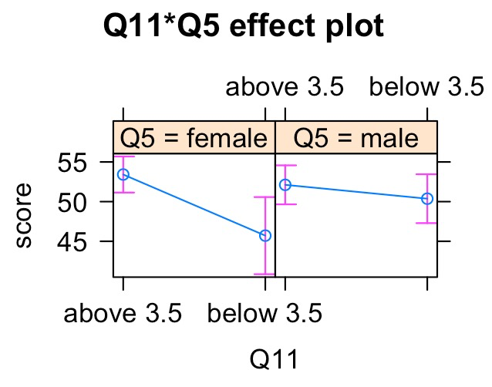
Interpretation of Interaction
We can observe an increase in the mean imposter syndrome scores as we switch from below a 3.5 GPA to above 3.5 GPA. we can see that
On average female students tend to have higher imposter syndrome scores compared to males as GPA increases.
However, the interaction effect between GPA and gender is only marginally significant (p-value = 0.073), so we decided not to include the interaction term.

Slide 47
Model Output Interpretation
Intercept: Imposter Syndrome Scores
Q2_4: “I doubt if I can repeat my academic successes.”
Feelings of fraudulence.
Q2_6: “I tend to compare myself with others.”
Tendency to compare.
Q2_9: “I do not think I belong at UCLA.”
Feelings of estrangement.
Q11: GPA (baseline = above 3.5)

Slide 48
Model Output
 | Estimate | Std. Error | t value | p value | Sig. Level
(Intercept) | 28.7288 | 2.6484 | 10.848 | <2e-16 | ***
Q2_4 | 1.4507 | 0.4353 | 3.332 | 0.00129 | **
Q2_6 | 2.0855 | 0.4990 | 4.179 | 7.28e-05 | ***
Q2_9 | 2.6895 | 0.4466 | 6.023 | 4.65e-08 | ***
Q11below 3.5 | -3.7649 | 1.6351 | -2.303 | 0.02384 | *
R-squared = 0.6886; adjusted R-squared = 0.6735. Both measures improved after we removed the outlier and the bad leverage observations (R-squared = 0.6636; adjusted R-squared = 0.6475 from the previous model).

Slide 49
Model Output Interpretation
Keeping everything else constant:
Q2_4: for every one unit increase in ratings of feelings of fraudulent, on average the imposter syndrome increases by 1.45 units.
Q2_6: for every one unit increase in tendency to compare, on average imposter syndrome increases by 2.09 units.
Q2_9: for every one unit increase in feelings of estrangement, on average imposter syndrome increases by 2.69 units.
Q11: switching from the below 3.5 GPA to the above 3.5 GPA, on average imposter syndrome is going to increase by 3.76 units.
Adjusted R-squared: After adjusting for the number of predictors in the model, we were able to explain 67.35% of the total variation in imposter syndrome scores.

Slide 50
Research Questions
Can we predict a person’s imposter syndrome score from existing scales using a newly developed scale that contains statements pertaining specifically to their experiences at UCLA?
Answer: Yes! Using feelings of academic fraudulence, tendency to compare, feelings of estrangement, and GPA, we are able to explain 67.35% of the total variation in imposter syndrome scores.

Slide 51
Part II:
Categorical Outcome
Notes:
Okay, part II. Let’s talk about the categorical outcome.

Slide 52
Rationale for Part II
In additional to the multiple linear regression model we had in part I, we decided to also include a multiple logistic regression model.
MLR provides a unit-based explanation of relationships between predictors and outcome variable.
Since we also collected a categorical measure of imposter syndrome, a more intuitive approach is to use a multiple logistic regression to look at the odds of a person selecting a certain answer given their prior responses on other measures.
To further simplify the model, we could also convert our predictors from numerical to binary.
Notes:
So basically, the purpose of this part is to create a model that can predict the odds of a person having imposter syndrome using the binary version of the previously mentioned predictors. So looking at the flow part, part two is about the green portion of the outcome variable. In short, we want to come up with a model that more intuitively describes the relationships between the predictors and imposter syndrome.

Slide 53
Exploratory Data Analysis
Notes:
Let’s talk about our good old friend EDA!

Slide 54
Categorical Outcome Variable
Frequency table of response
 | yes | no | maybe
count | 31 | 37 | 21
The frequencies are balanced, but to simplify the model and increase interpretability, we decided to convert the variable to binary (yes vs. no)
Notes:
Here’s the frequency table of response from Question 3. Question 3 essentially records whether a person thought they had imposter syndrome or not, and the frequencies look balanced. But to make the model more interpretable, we decided to make it binary.

Slide 55
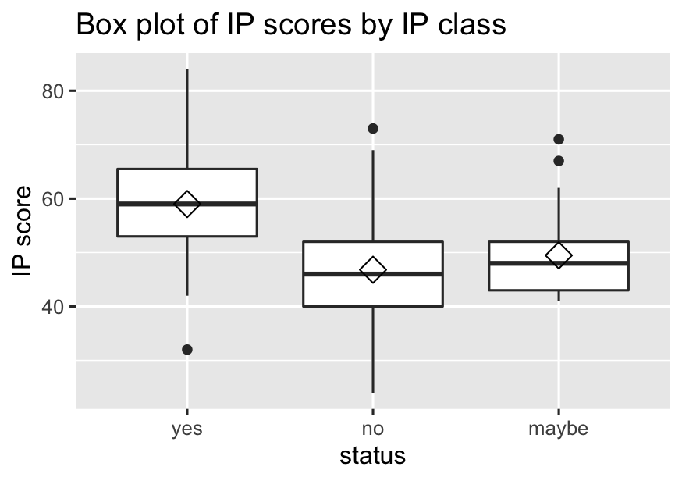
Box Plot with Group Mean
 | diff | p adjusted
no - yes | -12.18919 | 0.0000118
maybe - yes | -9.52381 | 0.0037748
maybe - no | 2.66538 | 0.6037405
At least one pair of means contains a significant difference (p-value = 1.37e-05; one-way ANOVA).
Tukey HSD results show that mean imposter syndrome score for people impacted by imposter syndrome is significantly higher than that of people who are not impacted by imposter syndrome or people who do not know whether they are impacted or not.
Notes:
Using a one-way ANOVA with Tukey post-hoc tests, we found that the “yes” group has significantly higher mean IP score than the other two groups; the “no” group and the “maybe” group do not differ significantly.

Slide 56
Categorical Outcome Variable
On one hand, it makes sense to group “no” and “maybe” together, since the two groups have similar mean imposter syndrome scores, so we have partial evidence to support that these two groups responded to survey questions in a similar fashion.
On the other hand, there may be systematic differences between people who chose the definite answer “no” and those who were not sure about whether they had imposter syndrome or not.
We decided to drop all “maybe” responses from the data to ensure that people from one class of the binary outcome variable are distinctively different from those from the other class.
Notes:
This result actually prompts us to group “maybe” and “no” together as the “no” group. But, at the same time there may be systematic differences that are not shown by numbers between the two groups. So we decided to drop all “maybe” responses for part II, just so we can make sure that we have a clean cut between the “yes” group and the “no” group.

Slide 57
Categorical Outcome Variable
Frequency table of response
 | yes | no | maybe
count | 31 | 37 | 21
After we dropped all “maybe” responses, the new data set contains 68 samples in total.
The outcome variable becomes a binary one with two balanced classes “yes” and “no”.
 | yes | no
count | 31 | 37
Balanced
Notes:
So, in the end we had 68 observations, and the outcome variable is still pretty balanced.

Slide 58
Binarize Predictors
 | low | high
Q2_1 | 35 | 33
Q2_2 | 34 | 34
Q2_3 | 32 | 36
Q2_4 | 34 | 34
Q2_5 | 38 | 30
Q2_6 | 14 | 54
Q2_7 | 32 | 36
Q2_8 | 40 | 28
Q2_9 | 43 | 25
Q2_10 | 41 | 27
Q2_11 | 35 | 33
Q2_12 | 31 | 37
 | 1 | 2 | 3 | 4 | 5 | 6 | 7
Q2_1 | 13 | 10 | 12 | 9 | 15 | 3 | 6
Q2_2 | 6 | 15 | 13 | 13 | 10 | 4 | 7
Q2_3 | 10 | 10 | 12 | 7 | 14 | 7 | 8
Q2_4 | 12 | 12 | 10 | 5 | 12 | 10 | 7
Q2_5 | 17 | 12 | 9 | 5 | 14 | 5 | 6
Q2_6 | 2 | 7 | 5 | 6 | 10 | 24 | 14
Q2_7 | 10 | 12 | 10 | 6 | 7 | 11 | 12
Q2_8 | 15 | 16 | 9 | 12 | 7 | 3 | 6
Q2_9 | 18 | 23 | 2 | 8 | 8 | 2 | 7
Q2_10 | 11 | 16 | 14 | 11 | 7 | 5 | 4
Q2_11 | 6 | 18 | 11 | 11 | 12 | 6 | 4
Q2_12 | 8 | 8 | 15 | 15 | 10 | 8 | 4
If rating < 4, convert to low.
Mostly
balanced
If rating >= 4, convert to high.
Notes:
We also decided to convert all predictors to binary. Recall that each question was rated on a scale from 1 to 7. Here, ratings lower than 4 were grouped as “low”, and those greater than or equal to 4 were grouped as “high”. The frequencies for the transformed predictors turned out to be mostly balanced as well.

Slide 59
Variable Selection
LASSO
Best subset selection
Model selection criteria
AKaike’s Information Criteria (AIC)
Bayesian Information Criteria (BIC)
Given our data set is shrunk to 68 observations, we decided to remove all imbalanced grouping variables from the data set before performing any variable selection.
Notes:
We are definitely not going to include all predictors and grouping variables in the model, because that would make the final model overly complex. Similar as before, we performed variable selection using three methods: LASSO, best subset selection based on AIC, and one that based on BIC. We also dropped all imbalanced grouping variables beforehand.

Slide 60
Interpretation of LASSO coefficients
We removed all imbalance grouping variables.
The only ones being retained are gender, major, and GPA.
Major is not technically a balanced grouping variable, so the inclusion of major is an arbitrary choice. Variable selection should be able to handle the question of whether we should include it or not.
Age was removed because other methods for variable selection used for Part II would output results with low interpretability. And it was previously shown not to be an important predictor.
Q2_2, Q2_3, Q2_4, Q2_5, Q2_6, Q2_7, and gender are the most important predictors selected by LASSO.
However, the coefficients of Q2_3, Q2_5, and gender are relatively low compared to those of other important predictors.
We decided to drop Q2_3 and Q2_5 because of their low importance.
We retained gender for its potential interaction with age.
 | s1
Intercept | 1.054
Q2_1low | .
Q2_2low | 0.214
Q2_3low | -0.061
Q2_4low | -0.921
Q2_5low | -0.121
Q2_6low | -1.187
Q2_7low | -1.176
 | s1
Q2_8low | .
Q2_9low | .
Q2_10low | .
Q2_11low | .
Q2_12low | .
Q2_5male | -0.121
Q2_10stem | .
Q11below 3.5 | .
Notes:
So now you are familiar with how we interpret the LASSO coefficients. The takeaway from the output is that question 2, 3, 4, 5, 6, 7 and gender are important. But we dropped question 3 and 5 because their coefficients are relatively small. Age was not included in the table because the other subset selection methods would give us complicated outputs for categorical variables with more than two levels, and we kept gender for its potential interaction with age, even though the importance of it is not high.

Slide 61
Variable Selection Continued
AIC selection
 | Estimate | Std. Error | z value | p value
(Intercept) | 1.392558 | 0.5562825 | 2.503330 | 0.012303
Q2_2low | 2.555847 | 1.2256978 | 2.085218 | 0.037050
Q2_4low | -1.751027 | 0.8294555 | -2.111056 | 0.034767
Q2_6low | -2.607491 | 1.2197435 | -2.137737 | 0.032538
Q2_7low | -1.552439 | 0.7925527 | -1.958784 | 0.050138
Q2_8low | -1.723294 | 1.1995878 | -1.436572 | 0.150840
Only Q2_2, Q2_4 , Q2_6, Q2_7, and Q2_8 are selected, but Q2_8 is not significant.
Notes:
Based on AIC, the best subset includes question 2, 4, 6, 7, and 8. But question 8 is not significant, and question 7 is only marginally significant.

Slide 62
Variable Selection Continued
BIC selection
 | Estimate | Std. Error | z value | p value
(Intercept) | 1.263595 | 0.4281335 | 2.951405 | 0.003163
Q2_4low | -2.876361 | 1.1374537 | -2.528772 | 0.011446
Q2_6low | -2.343506 | 0.6288221 | -3.726820 | 0.000193
Only Q2_4 and Q2_6 are selected, and both are significant.
Notes:
Based on BIC, the best subset includes only question 4 and 6. This selection contains fewer predictors because BIC imposes a higher penalty on complexity than AIC does.

Slide 63
Model Output
 | Estimate | Std. Error | z value | p value | Sig. Level
(Intercept) | 1.1947 | 0.5145 | 2.322 | 0.02024 | *
Q2_2low | 1.4448 | 0.7953 | 1.817 | 0.06927 | .
Q2_4low | -1.8132 | 0.8063 | -2.249 | 0.02453 | *
Q2_6low | -2.7583 | 1.2478 | -2.211 | 0.02707 | *
Q2_7low | -1.9234 | 0.7369 | -2.610 | 0.009505 | **
Notes:
By comparing the results from all three methods, we decided to only include question 2, 4, 6, and 7. Here’s the model output with these predictors. In this model, every predictor except question 2 is significant.

Slide 64
Model Output Interpretation
Q2_2: “ I feel like people like myself are underrepresented at UCLA”
Lack of diversity.
Not statistically significant, but close to the significance level.
Q2_4: “I doubt if I can repeat my academic successes.”
Feelings of academic fraudulence.
Q2_6: “I tend to compare myself with others.”
Tendency to compare.
Q2_7: “I think most people are more academically competent than myself.”
Feelings of academic inferiority.
Notes:
So now let’s look at what each question or statement is about. Question 2 is about lack of diversity. Question 4 measures feelings of academic fraudulence. Question 6 looks at the tendency to compare. And question 7 measures feelings of academic inferiority.

Slide 65
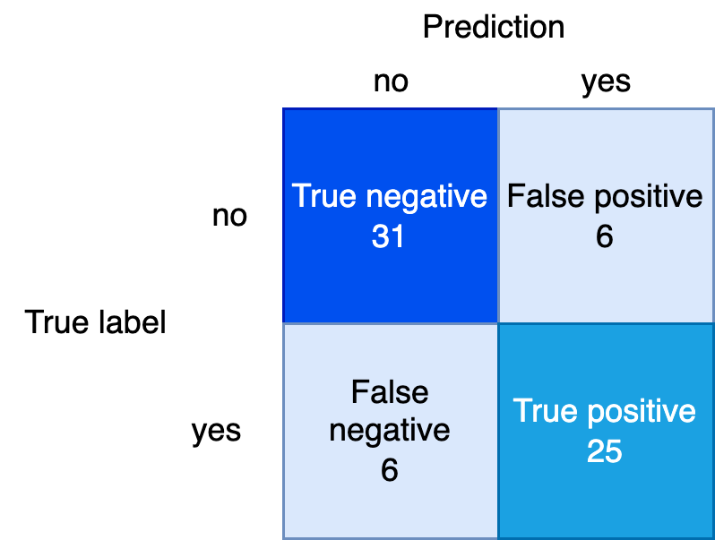
Model Accuracy
Error rate = (6 + 6) / (31 + 25 + 6 + 6) = 0.1764706
Model accuracy = 1 - error rate = 0.8235294
Notes:
In addition, based on the confusion matrix, our model is able to make correct predictions about 82.4% of the time.

Slide 66
Model Output with Interaction
 | Estimate | Std. Error | z value | p value | Sig. Level
(Intercept) | 1.62707 | 0.69375 | 2.345 | 0.01901 | *
Q2_2low | 1.51709 | 0.84666 | 1.792 | 0.07316 | .
Q2_4low | -1.80376 | 0.83456 | -2.161 | 0.03067 | *
Q2_6low | -2.80850 | 1.23344 | -2.277 | 0.02779 | *
Q2_7low | -2.00401 | 0.77117 | -2.599 | 0.00936 | **
Q5male | -0.89261 | 0.76231 | -1.171 | 0.24163
Q11below 3.5 | 0.07276 | 1.44944 | 0.050 | 0.95996
Q5male:Q11 below 3.5 | 0.20236 | 1.86577 | 0.108 | 0.91363
Notes:
We also tried to include the interaction between gender and GPA in the model. Previously in the MLR model, we found that the interaction is marginally significant, but here we found that the interaction is not significant at all.

Slide 67
Model Accuracy with Interaction
Error rate = (6 + 6) / (31 + 25 + 6 + 6) = 0.1764706
Model accuracy = 1 - error rate = 0.8235294
Notes:
And including the interaction does not improve prediction accuracy at all.

Slide 68
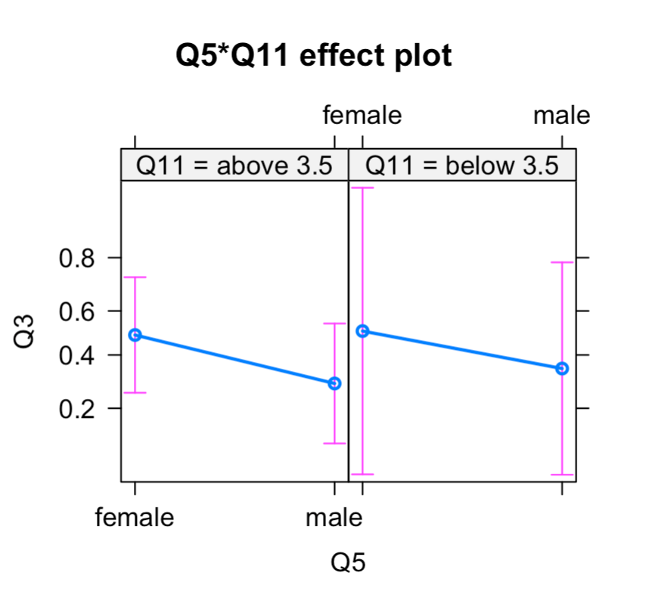
Model Accuracy with Interaction
The interaction term is not significant, and the two parallel lines in the interaction plot also indicates no interaction. Since adding the interaction effect to the model has no influence on the model’s accuracy, we should probably go with the simpler model without interaction term.
Notes:
The interaction plot also shows two parallel lines, meaning that there’s no interaction going on between gender and GPA. So we decided not to include this interaction.

Slide 69
Model Output
 | Estimate | 2.5% CI | 97.5% CI | Std. Error | z value | p value | Sig. Level
(Intercept) | 1.1947 | 0.2410 | 2.2911 | 0.5145 | 2.322 | 0.02024 | *
Q2_2low | 1.4448 | 0.0060 | 3.2041 | 0.7953 | 1.817 | 0.06927 | .
Q2_4low | -1.8132 | -3.5543 | -0.2948 | 0.8063 | -2.249 | 0.02453 | *
Q2_6low | -2.7583 | -5.9241 | -0.6763 | 1.2478 | -2.211 | 0.02707 | *
Q2_7low | -1.9234 | -3.4700 | -0.5248 | 0.7369 | -2.610 | 0.009505 | **
Classification accuracy = 0.8235294
Notes:
As a recap, here is our final model output.

Slide 70
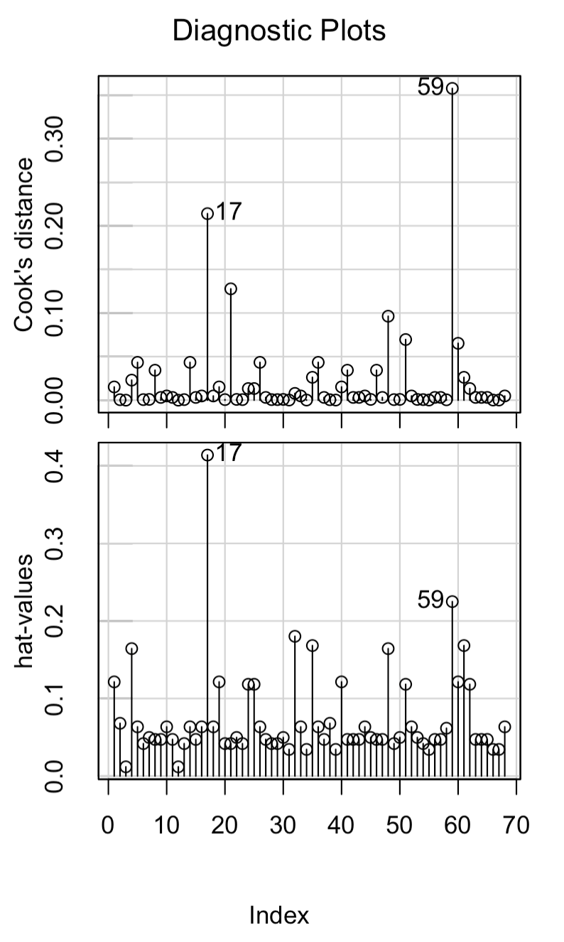
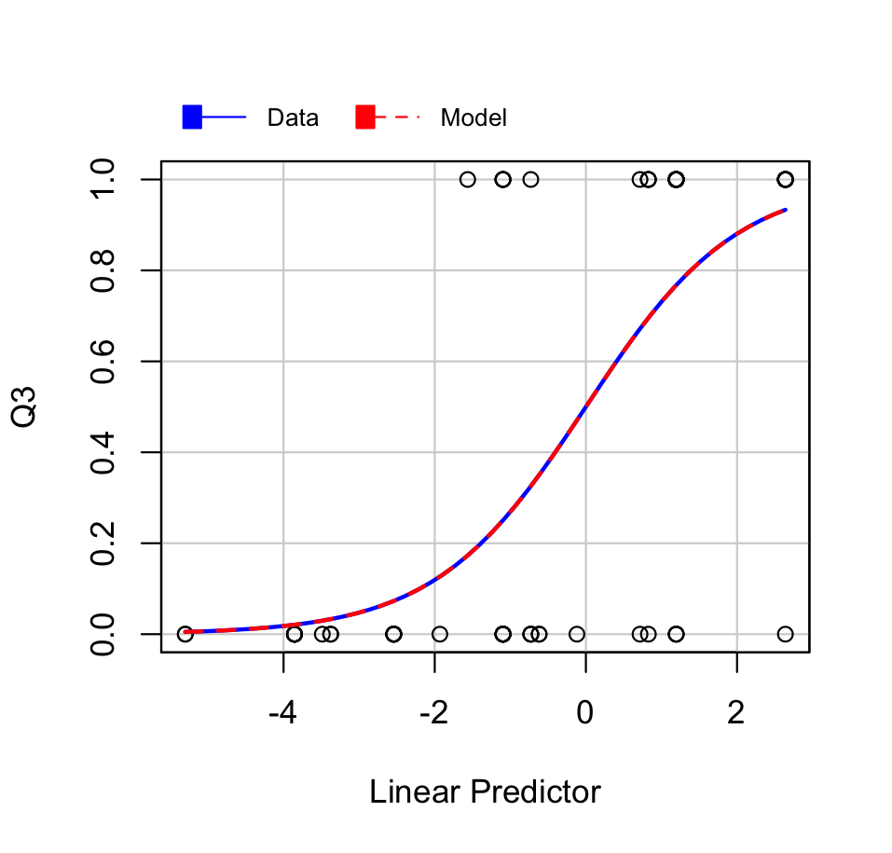
Influential Plots and Marginal Model Plot
The influential plots show that observations 17 and 59 are high leverage points.
However, removing these two observations changed the standard error of the coefficient of Q2_6 in the multiple logistic regression model from 1.2478 to 1730.6908, which by no means is a normal pattern.
Without removing the two leverage points, the marginal model plot shows that our multiple logistic regression model seems to capture the patterns in the data set.
In the end, the observations 17 and 59 were not removed from the model.
Notes:
We then checked for influential points in our model. The influential plots show that observation 17 and 59 are high leverage points. And removing these two observations leads to abnormal output. More specifically, the standard error of question 6 increased from one point two to seventeen hundred, so these two points maybe actually be important observations that stabilize the model. Also, the marginal model plot without removing the high leverage points seems okay. So we did not remove observation 17 and 59 in the end.

Slide 71
Model Output Exponentiated
 | Estimate | 2.5% CI | 97.5% CI | p value | Sig. Level
(Intercept) | 3.3026 | 1.2726 | 9.8860 | 0.02024 | *
Q2_2low | 4.2410 | 1.0061 | 24.6339 | 0.06927 | .
Q2_4low | 0.1631 | 0.0286 | 0.7447 | 0.02453 | *
Q2_6low | 0.0634 | 0.0027 | 0.5085 | 0.02707 | *
Q2_7low | 0.1461 | 0.0311 | 0.5917 | 0.009505 | **
Notes:
Here’s the same model output as before, except that all coefficients are exponentiated.

Slide 72
Model Output Interpretation
Q2_2: “ I feel like people like myself are underrepresented at UCLA”
Perception of diversity.
Not statistically significant, but close to the significance level.
Q2_4: “I doubt if I can repeat my academic successes.”
Feelings of academic fraudulence.
Q2_6: “I tend to compare myself with others.”
Tendency to compare.
Q2_7: “I think most people are more academically competent than myself.”
Feelings of academic inferiority.
Notes:
Here’s a quick recap of what each statement is about.

Slide 73
Model Output Interpretation
Keeping everything else constant:
The odds of having imposter syndrome is 83.69% less for people with low perception of academic fraudulence compared to people with high perception of academic fraudulence.
The odds of having imposter syndrome is 93.66% less for people with low tendency to compare themselves with other compared to people with high tendency to compare.
The odds of having imposter syndrome is 85.39% less for people with low perception of academic inferiority compared to people with high perception of academic inferiority .
Notes:
Okay, let’s interpret the model outputs together. So, if we keep everything else constant, the odds of having imposter syndrome for people with low perception of academic fraudulence is about 84% lower. For people with low tendency to compare, the odds of having imposter syndrome is about 94% lower. And lastly, for people with low perception of academic inferiority, the odds of having imposter syndrome is about 85% lower.

Slide 74
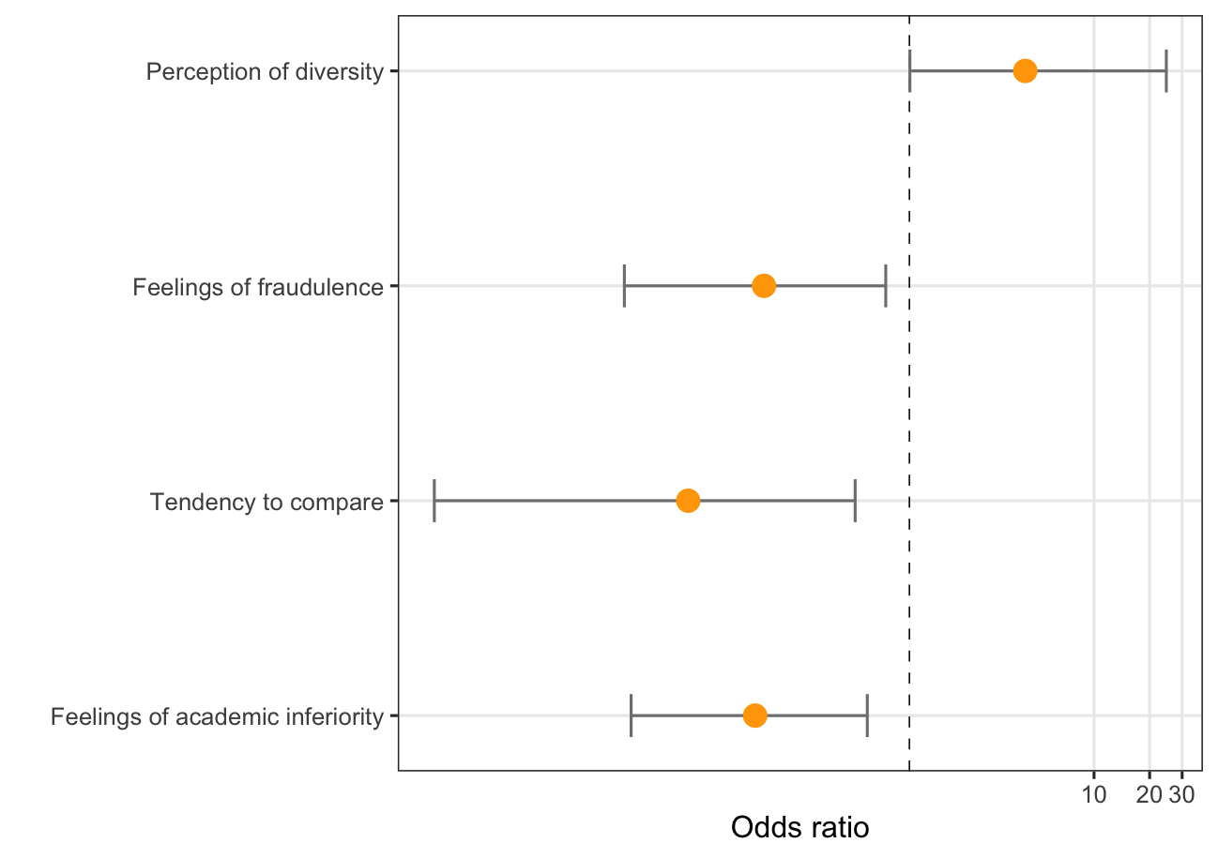
Visualization of the Model Output
The dotted line indicates a odds ratio of 1, or even odds. All of the significant predictors have confidence intervals that do not capture 0. Because these intervals are on the left of the even odds line, they show that the odds of having imposter syndrome will be less for those who have low perceptions of these measures.
Notes:
We also visualized the model outputs. The dotted line in the middle indicates even odds, and the main idea behind this plot is that, for people who were “low” on any of the three significant measures, their odds of having imposter syndrome will be also significantly lower than people who scored “high” on them.

Slide 75
Research Questions
Can we predict the odds of a person being impacted by imposter syndrome using statements from the newly developed scale that contains statements pertaining specifically to their experiences at UCLA?
Answer: Yes! Using feelings of fraudulence, tendency to compare, and feelings of academic inferiority, we are able to make correct predictions about whether a person has imposter syndrome or not 82.35% of the time.
Notes:
Now let’s go back to our research question. Can we predict the odds of a person being impacted by imposter syndrome? The answer is yes. Using feelings of academic fraudulence, tendency to compare, and feelings of academic inferiority, we make accurate predictions about 82.35% of the time.

Slide 76
Part III:
Text Analysis

Slide 77
Method
We took the text data from Q4, which asked respondents to describe a time when they were impacted by imposter syndrome, and to identify two potential reasons that made them feel like an imposter in the situation they just described.
We grouped the data based on whether the respondent answered “yes” “no” and “maybe” to Q3, which asked if they think they were impacted by impostor syndrome. We then generated a word cloud for each.

Slide 78
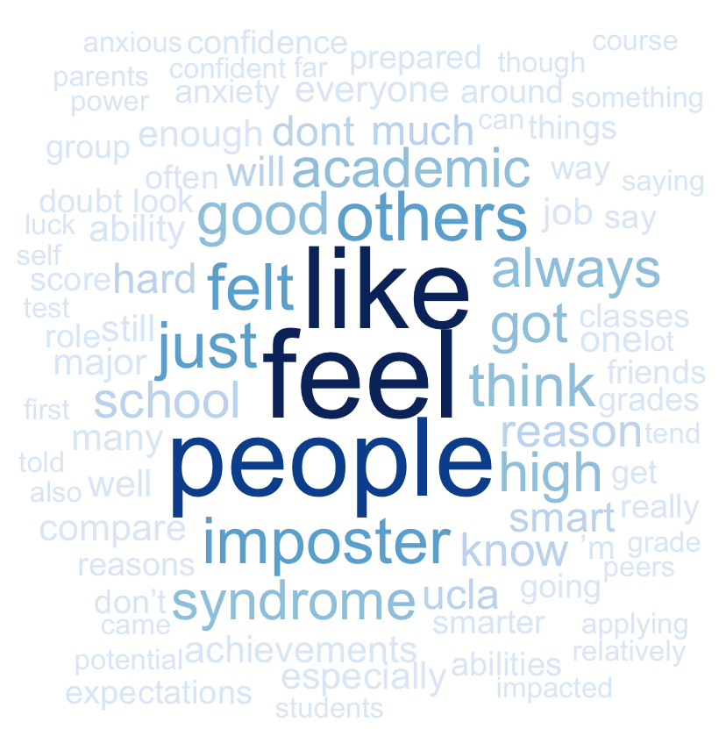
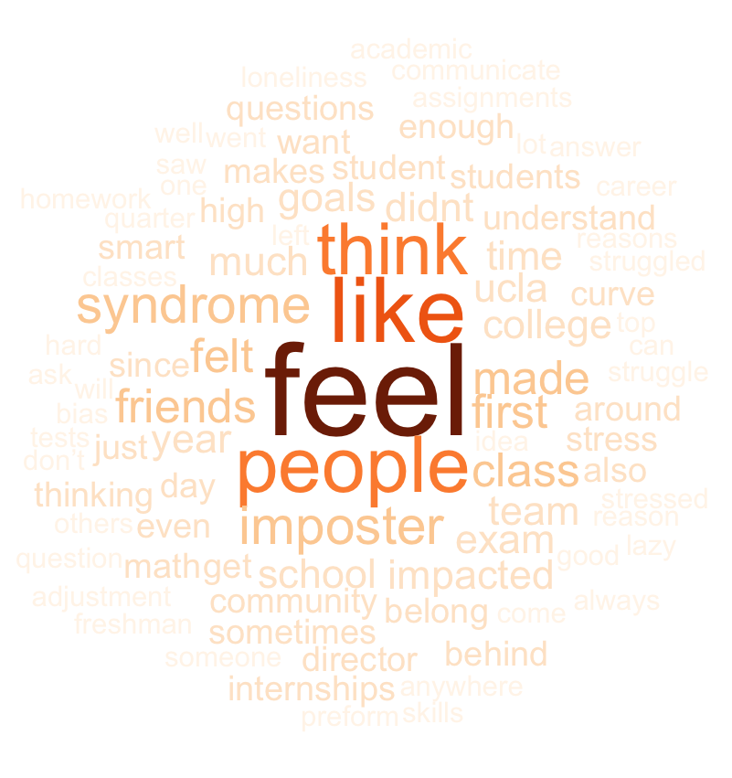
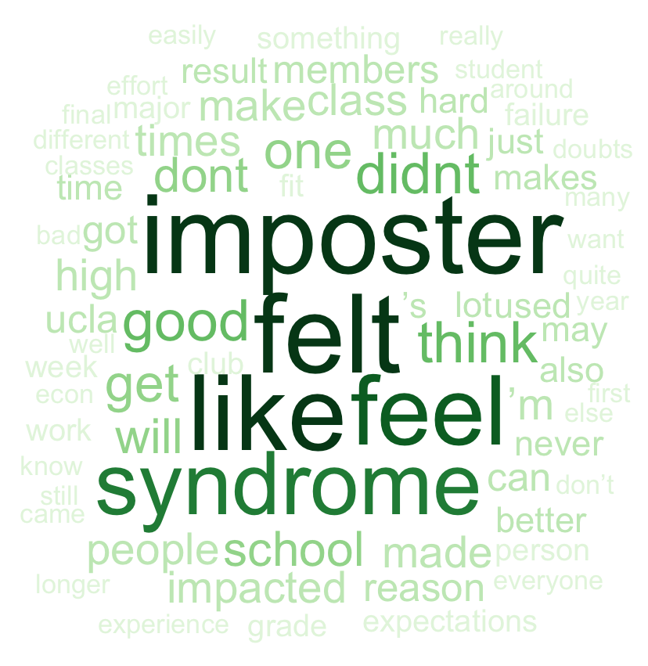
Text Clouds by Imposter Syndrome Status
YES
NO
MAYBE

Slide 79
Text Clouds by Imposter Syndrome Status
YES
NO
MAYBE
All 3 word clouds demonstrate roughly the same words as the most frequent. However, we noticed that the word “others” was included in the “yes” cloud but not in any of the other word clouds. This finding suggests that among those who believe they have been impacted by impostor syndrome, thoughts regarding other people may be more frequent among those who believe they have been impacted by imposter syndrome than in other groups. This is consistent with our finding that comparing oneself to others is one of the most important predictors of impostor syndrome.

Slide 80
Summary of Findings from Word Clouds
The word clouds shares the following similarities:
The most frequent words are the same: “feel”, “like”:
The responses focuses on respondent’s emotions and perceptions.
All mentioned “UCLA”:
No matter how the respondents feel about whether they are affected by imposter syndrome, they all use UCLA as a criterion.
And they are different in terms of:
The word cloud for people who identify as impacted by imposter syndrome contains relatively-high frequency words like “compare”, “around”, and “achievements” that the other two graphs does not:
People who are constantly comparing themselves with other people near them will tend to suffer more from imposter syndrome.
In the word cloud for “yes”, there are also words like “anxiety”, “confidence”, “role”, and “doubt” that do not appear on the other two graphs:
We interpret this as accounts of how students are likely to feel when experiencing imposter syndrome.
Notes:
For findings from our word clouds, we both identified similarities and differences. For the similarities, the most frequent words are all feel and like. This means that the responses reflect respondents’ emotions and perceptions. All graphs mentioned UCLA at a relatively high frequency, we believe that this is because no matter how our respondents feel, they all use ucla as a criterion to evaluate themselves.
The differences show that for the word cloud of yeses, words such as compare around and achievements are common. We interpret that this is because people who compare themselves to their surroundings more are likely to suffer more from imposter syndrome.
Words like anxiety, confidence, role and doubt also show up only on word cloud for yeses. We interpret this as accounts of how students are likely to feel when experiencing imposter syndrome.

Slide 81
Research Questions
Does the design of our project have high ecological validity? More specifically, do the results from our study match with what people think of imposter syndrome in reality?
Answer: Yes! We found people who thought they had imposter syndrome mentioned comparisons and thoughts regarding other people more often than those from the other two groups. This result matches our statistical analysis that comparison related predictors tend to be more important.
Notes:
So, here is the answer to our last research question.
(READ ONLY THE ANSWER PART QUICK)

Slide 82
Summary
People seem to have a good judgment about whether they have imposter syndrome or not.
People reported to have imposter syndrome scored significantly higher than people who didn’t.
Using feelings of academic fraudulence, tendency to compare, feelings of estrangement, and GPA as our numerical predictors, we are able to explain 67.35% of the total variation in imposter syndrome scores.
Using feelings of fraudulence, tendency to compare, and feelings of academic inferiority as our categorical predictors, we are able to make correct predictions about whether a person has imposter syndrome or not 82.35% of the time.
The interaction between gender and GPA is marginally significant. More specifically women with high achievements tend to have higher imposter syndrome scores.

Slide 83
Zero-In
Feelings of estrangement or lack of sense of belonging contributes to imposter syndrome.
Educate faculty and students about the significance of diversity and inclusion and create diverse and inclusive environments to cultivate sense of belonging.
Introduce students to support services offered on campus and make these services accessible.
Foster a sense of community in classes through promoting student-student and student-faculty interactions.

Slide 84
Zero-In
The tendency to compare oneself with others and the resulting perception of academic inferiority are the key components of imposter syndrome.
Shift the focus of comparison to personal growth. Grading systems can include a “personal improvement”component that is specific to each individual. For instance, writing courses take into account each student’s starting point and mainly use personal progress to evaluate performance.
Using absolute grading scales instead of the curving method to avoid direct ranking of students.
Promote collaborative interaction or group work between students to loosen the competitive atmosphere.
Students can learn to look at comparisons from a different len. For instance, instead of using comparisons as a means to degrade our achievements, focus on how we can improve and learn from people who we think are better than us.

Slide 85
Zero-In
Among different measures of feelings of fraudulence, the most important element is whether one can repeat their academic successes.
Assessment standards need to yield consistent results of one’s academic abilities and minimize the role of luck in scoring. For example, quizzes and exams should maintain similar levels of difficulty and contain similar type of questions.
Offer more opportunities for feedback and assessment might be helpful. For instance, the midterm-final system can be broken down into more frequent and less stressful assessments. On one hand, students will have more opportunities to repeat their academic successes. On the other hand, students can keep track of their personal progress and effort and avoid arbitrary attributing successes to luck.

Slide 86
Limitations
The study overall suffered from small sample size.
The data came mostly from Asian and STEM-majoring participants, which limits the study’s generalizability.
Models were constructed exclusively to understand the data in-hand, and prediction accuracy was not the focus of the study. Therefore, the results may have high variability.
Overemphasizing interpretability may lead to bias in variable selection.
Voluntary response allowed participants to skip questions, which resulted in loss of observations that may possess specific characteristics.

